Slide 1
Project Management 101
How to organize your time and yourself

Slide 2
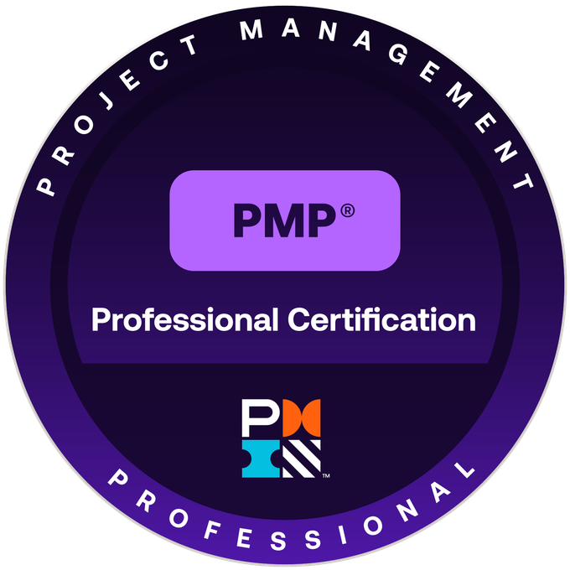
How am I qualified to tell you what to do?
Masters of Public Affairs (2005)
Certified Project Management Professional (2016)
Certified Nonprofit Professional (expected 2025)
20+ years of experience in for-profit, NPO, and government
Never pulled an all-nighter
Never missed a deadline (almost)

Slide 3
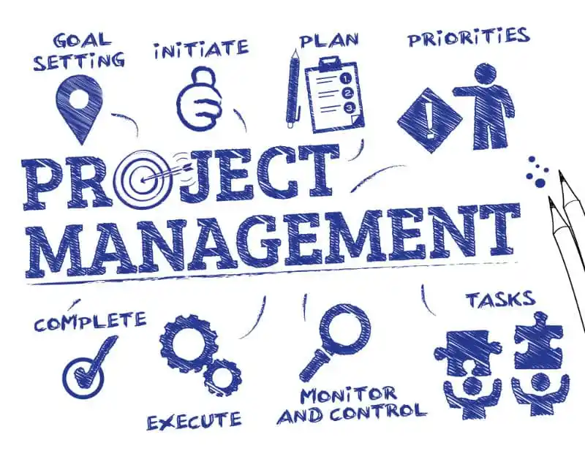
So, what is project management?
Planning
Organizing
Directing
Within constraints including:
Time
Budget
Scope

Slide 4
What we’re going to talk about:
Task and time management
Writing and document creation
What to do when you have too much to do
Tools

Slide 5
Task and Time Management

Slide 6

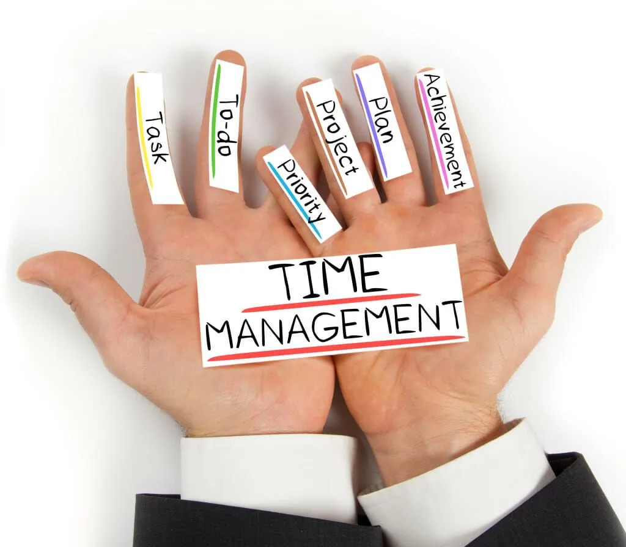
Task and Time Management
To-do lists
Time management tools

Slide 7
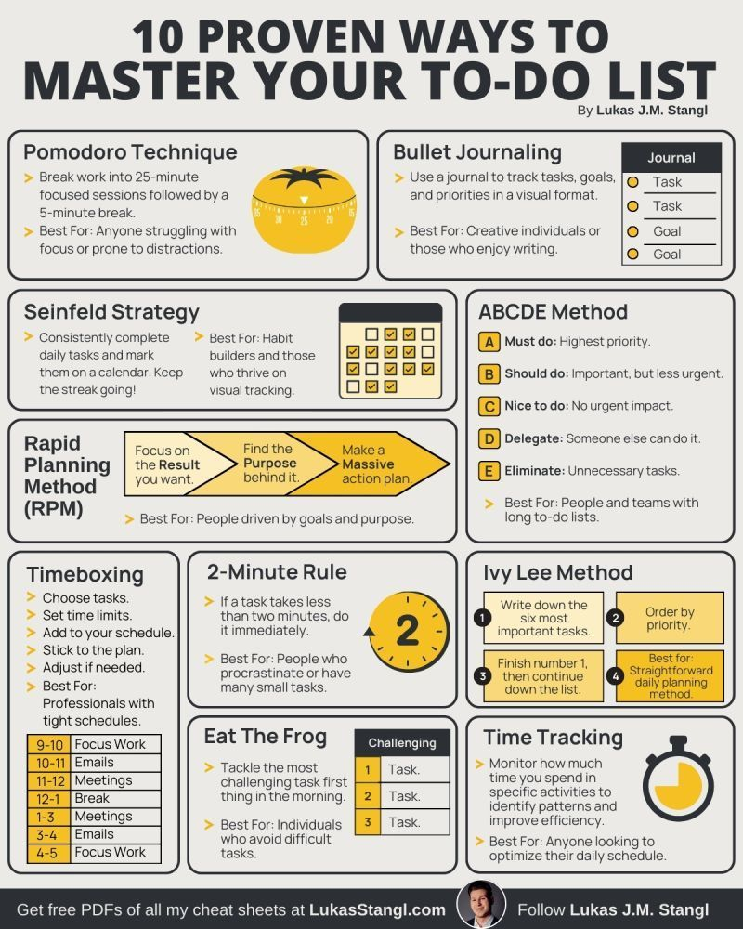
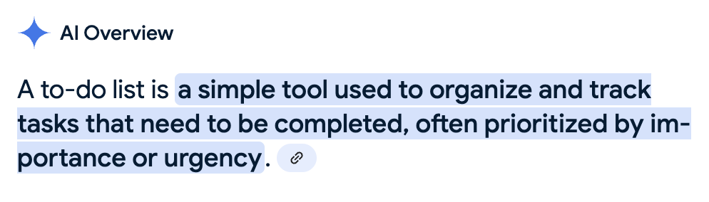
General tips
Ivy Lee Method
Eisenhower Matrix
Kanban

Slide 8
Tips for Effective To-Do Lists
Be Specific: Ensure each task has a clear action associated with it to avoid ambiguity.
Limit Your Daily List: Focus on a manageable number of tasks to avoid overwhelm and maintain focus.
Prioritize Regularly: Review and update your to-do list to ensure it aligns with your goals and priorities.
Use Visual Cues: Employ color-coding, highlights, or other visual techniques to organize and prioritize tasks.
Allow for Flexibility: Be prepared to adjust your to-do list as unexpected events or changes arise.

Slide 9
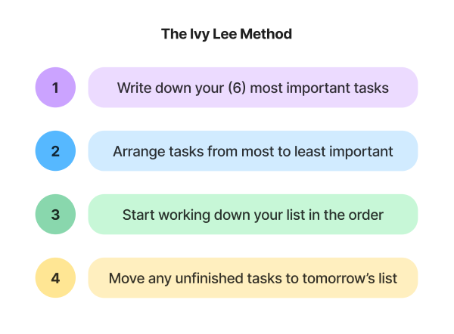
To-do list method #1: Ivy Lee Method
Who is this method best for?
Folks who don’t usually use a to-do list
Folks who struggle with prioritization and overwhelm
Keys to making this method work:
Embrace the limits–not more than six items
Break extra-large tasks down into steps

Slide 10
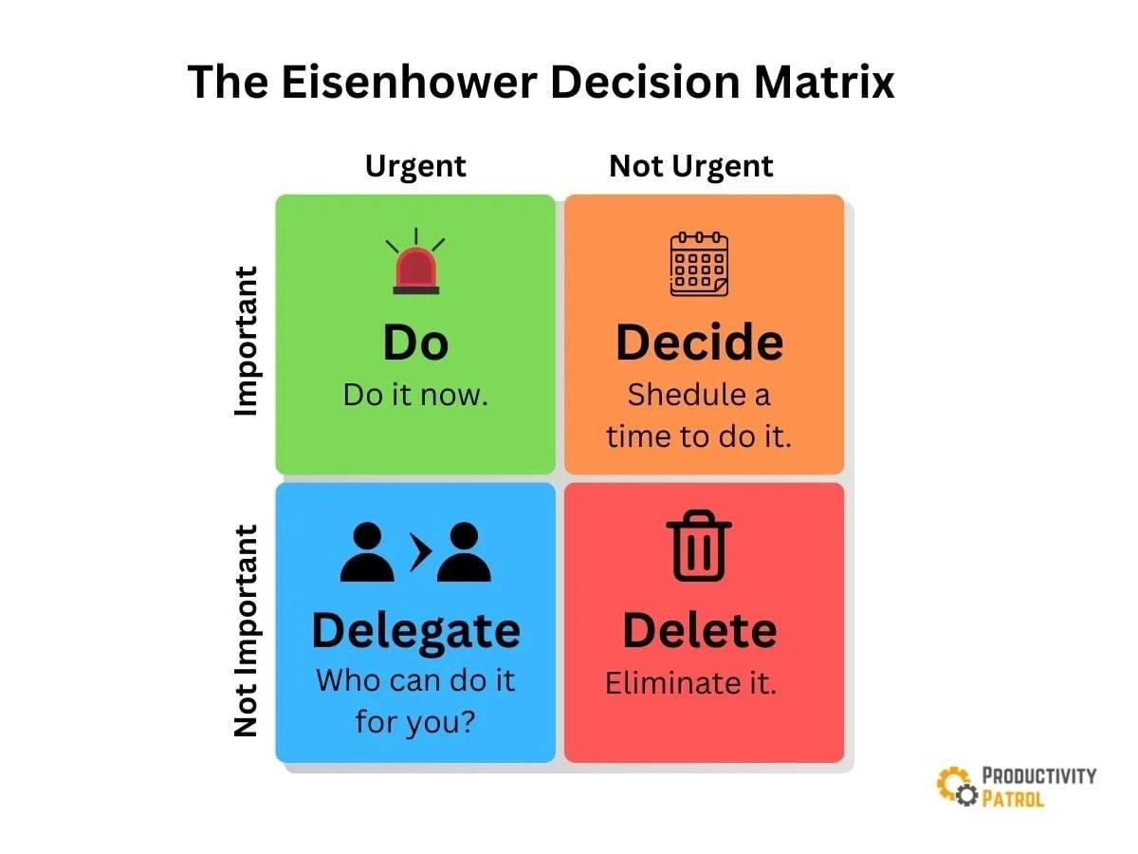
To-do list method #2: Eisenhower Matrix
Who is this method best for?
Those who struggle with prioritization
Keys to making this method work:
Honest analysis of urgency and importance
Delegation and deletion

Slide 11
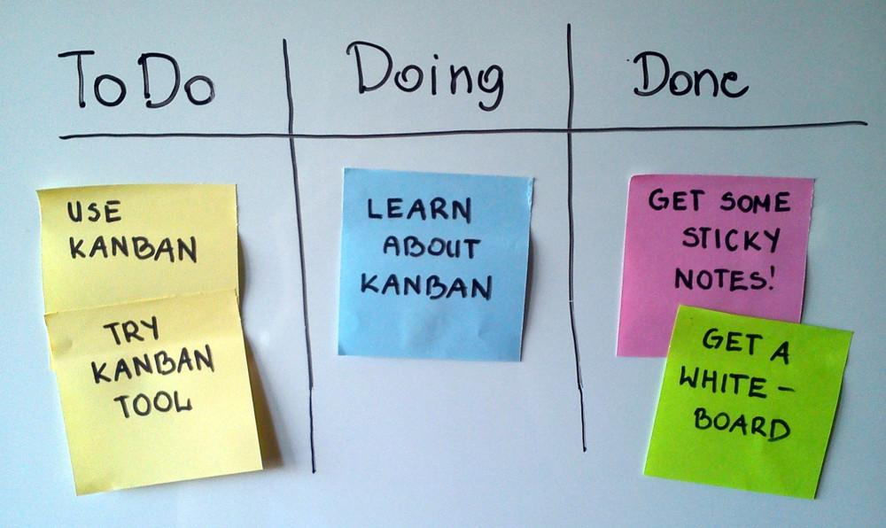
To-do list method #3: Kanban
Keys to making this method work:
Visualize the work
Limit the WIP
Focus on flow
Who is this method best for?
Visual thinkers
Teams

Slide 12
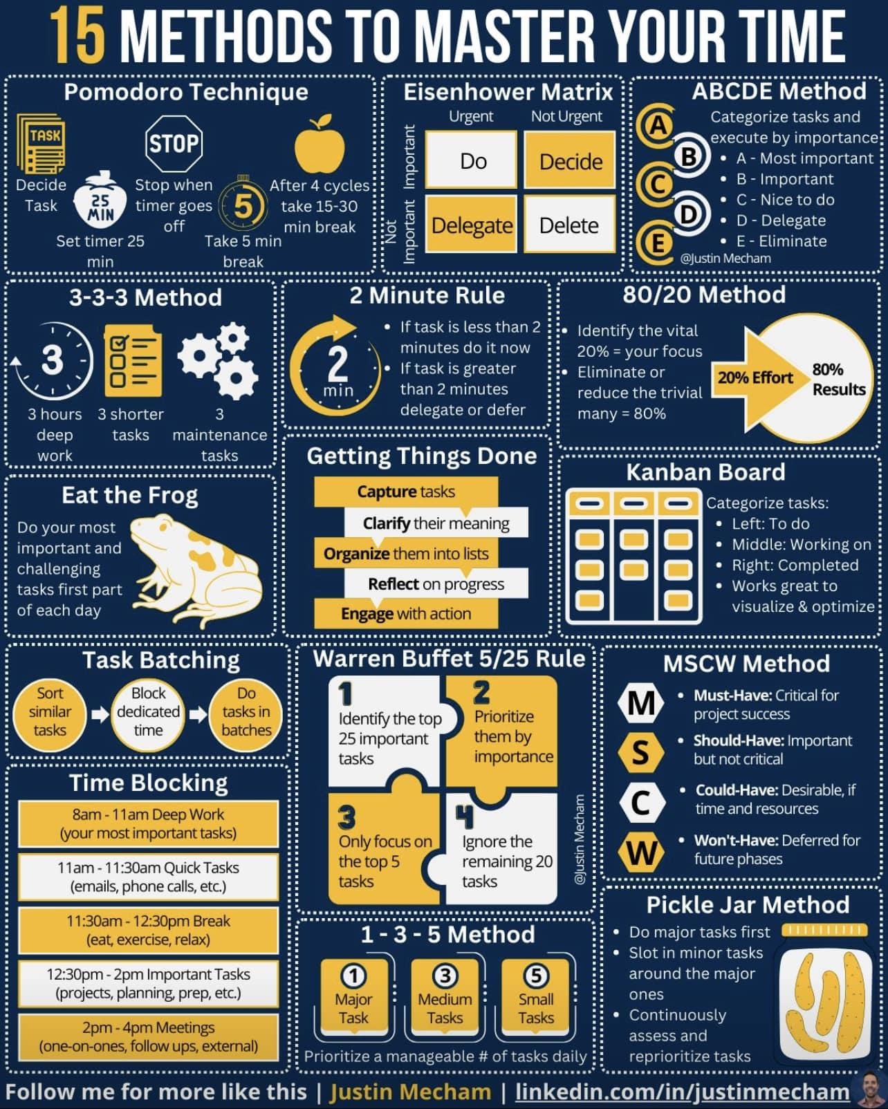
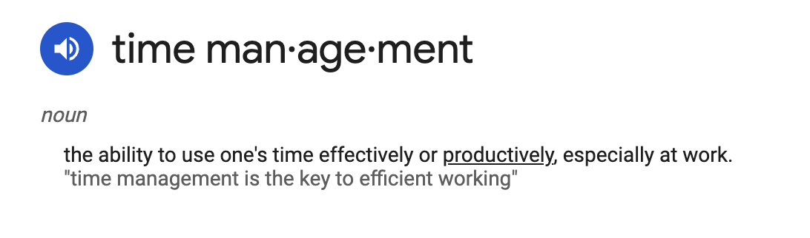
Pomodoro Technique
Time Boxing
Pickle Jar Method

Slide 13
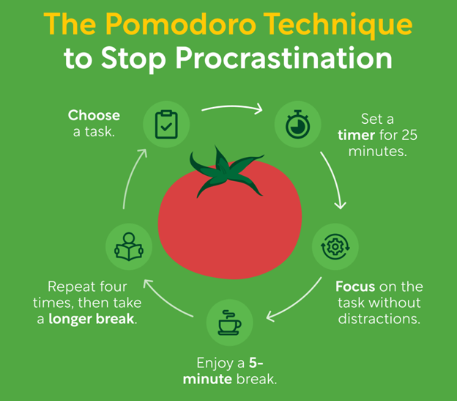
Time management method #1: Pomodoro Technique
Keys to making this method work:
Use an actual timer and don’t cheat
Turn off distractions–notifications, etc.
Change time intervals when needed
Who is this method good for?
PROCRASTINATORS!!

Slide 14
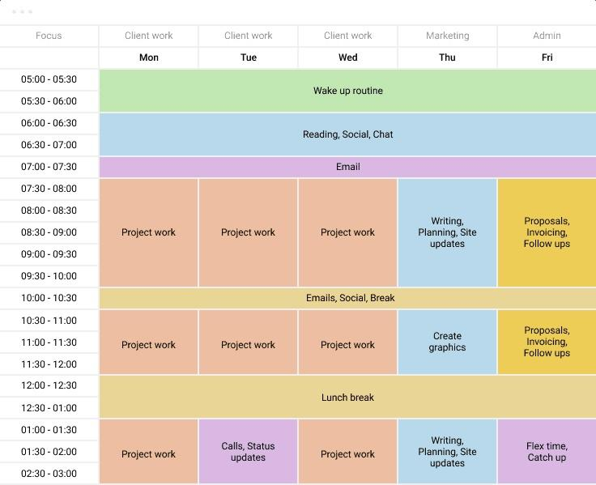
Time management method #2: Time Boxing
Keys to making this method work:
Follow your calendar
Be realistic about your time blocks
Minimize disruptions during head-down periods
Who is this method best for?
Those with task-transition troubles
Those with strict schedules

Slide 15
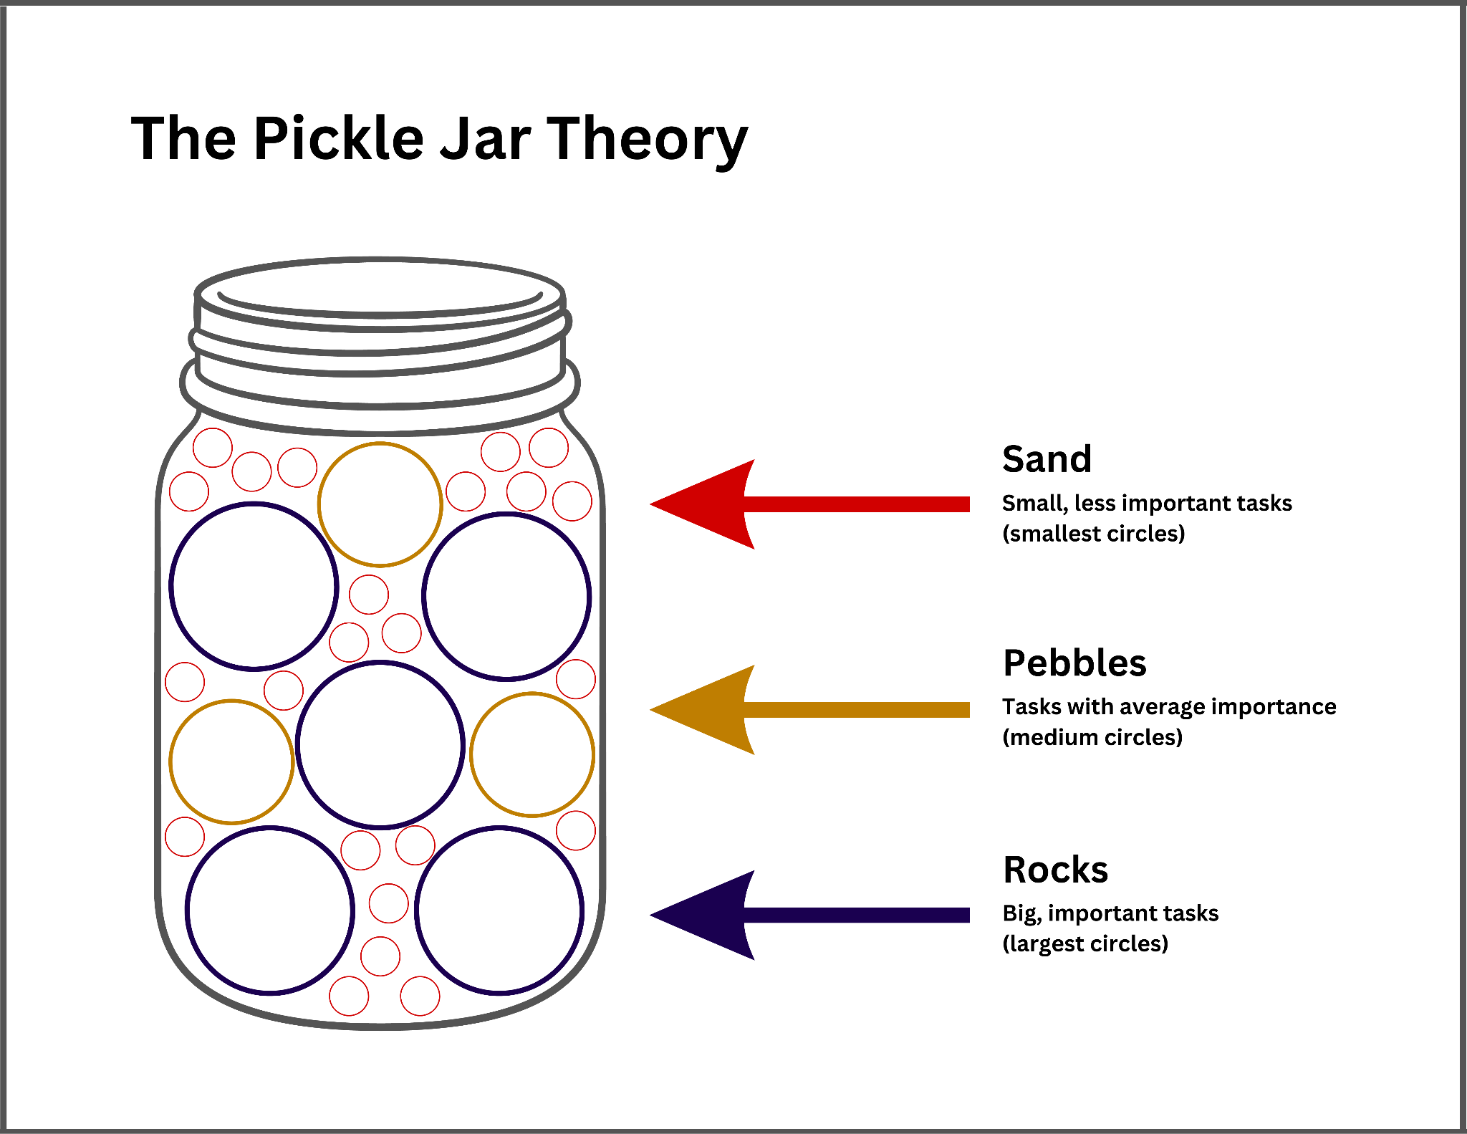
Time management method #3: Pickle Jar Method
Who is this method best for?
Those who struggle with balancing tasks and balancing work and personal life
Keys to making this method work:
Identify priorities
Use small time chunks effectively
Focus on balance

Slide 16
2. Writing and Document Creation

Slide 17
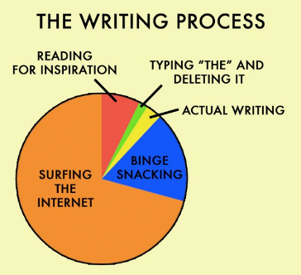
2. Writing and document creation
First principle: do not start with a blank page
Second principle: the goal is not perfect, the goal is complete

Slide 18
How not to start with a blank page
Outlining
Free writing
AI-generated drafting
Overwriting

Slide 19
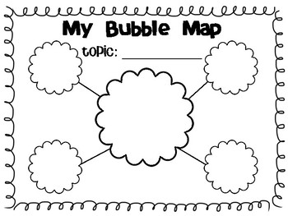
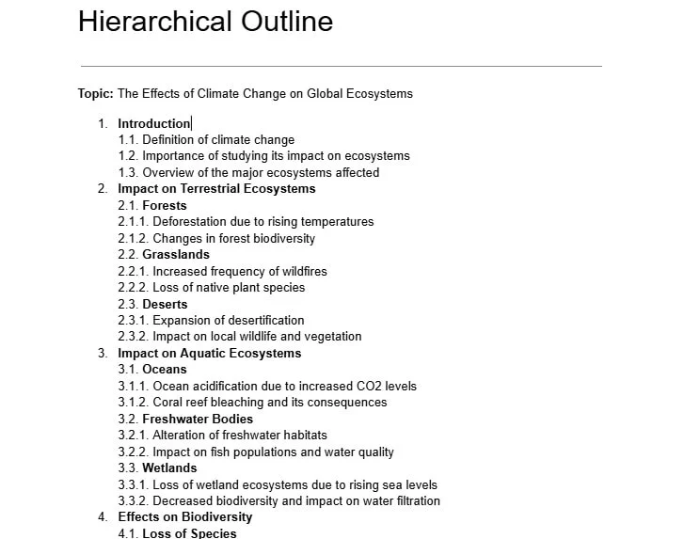
Outlining
Thesis statement
Main points organized logically
Supporting details organized hierarchically

Slide 20
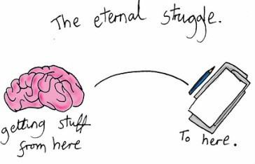
B. Freewriting
Don’t pause
Don’t erase
Don’t worry about the details (spelling, punctuation, grammar)
Tools to use include 750words.com and sprinter.getfreewrite.com/

Slide 21

C. Writing with AI
Consider your prompts
Set parameters
Best in combination with other strategies

Slide 22
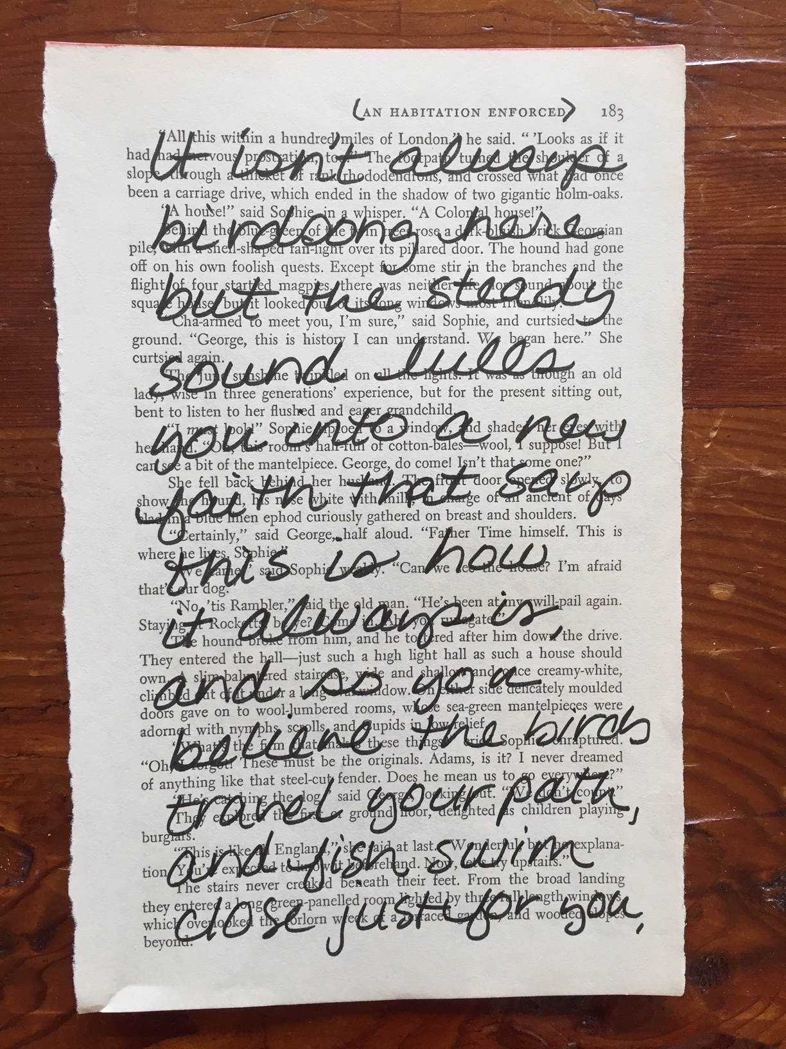
D. Overwriting
Start with a previously completed document
Salvage what you can for reuse
Delete what you can’t use

Slide 23


Slide 24
Get to MVP
(Minimum Viable Product)

Slide 25
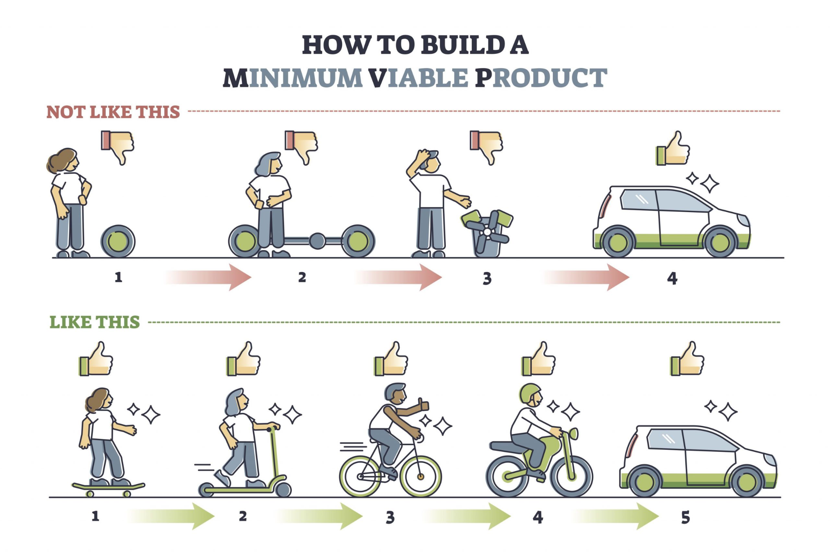

Slide 26
3. What to do when you have too much to do

Slide 27
Remediating overwhelm
Manage your time ✔
Break big tasks into smaller tasks
Triage
Thought and accountability partnership
And also:
Delegate
Change your environment
Say no

Slide 28
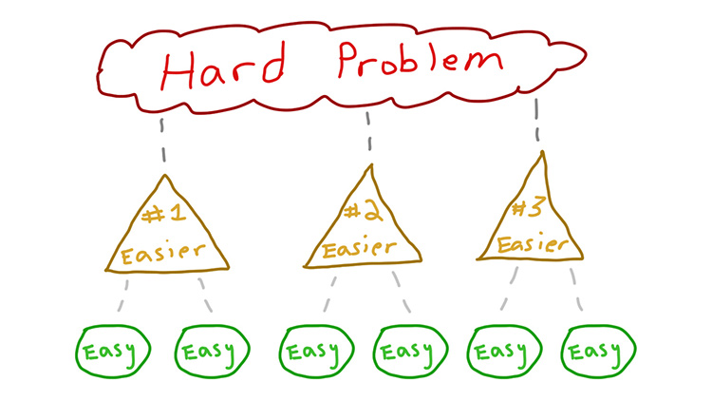
Task breakdown
Consider the whole problem
Simplify as much as possible
Find natural break points
Identify sub-tasks
Document!

Slide 29
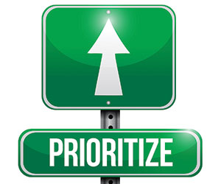
B. Task triage
Is the task related to your top priorities?
Is the task time sensitive?
Does the task truly need be done?
Does it need to be done by you?

Slide 30
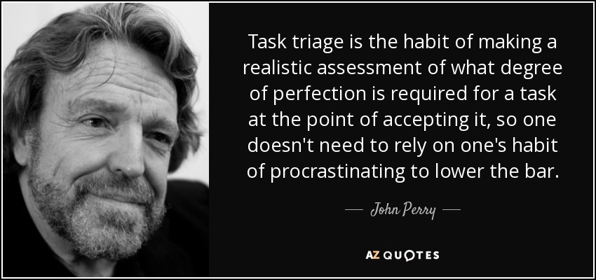

Slide 31
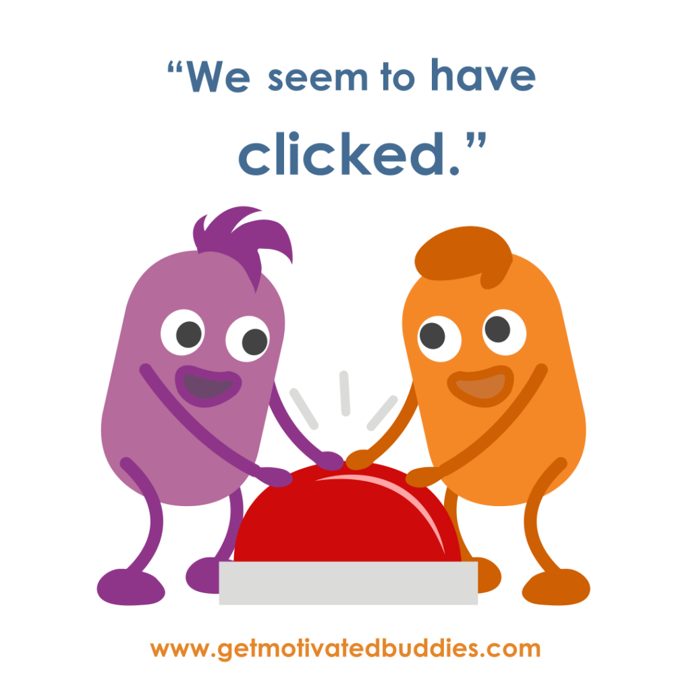
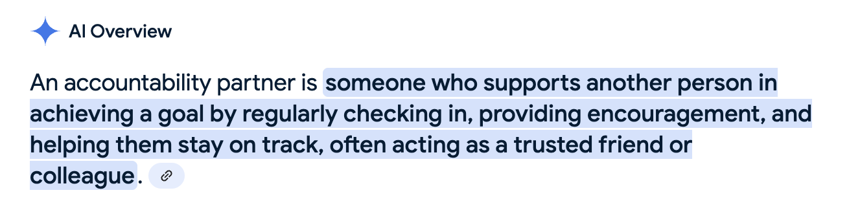
C. Thought and accountability partnership
Find someone who:
You trust and are comfortable with
Has similar goals and challenges
Understands your work
You see/speak to often

Slide 32
4. Tools

Slide 33
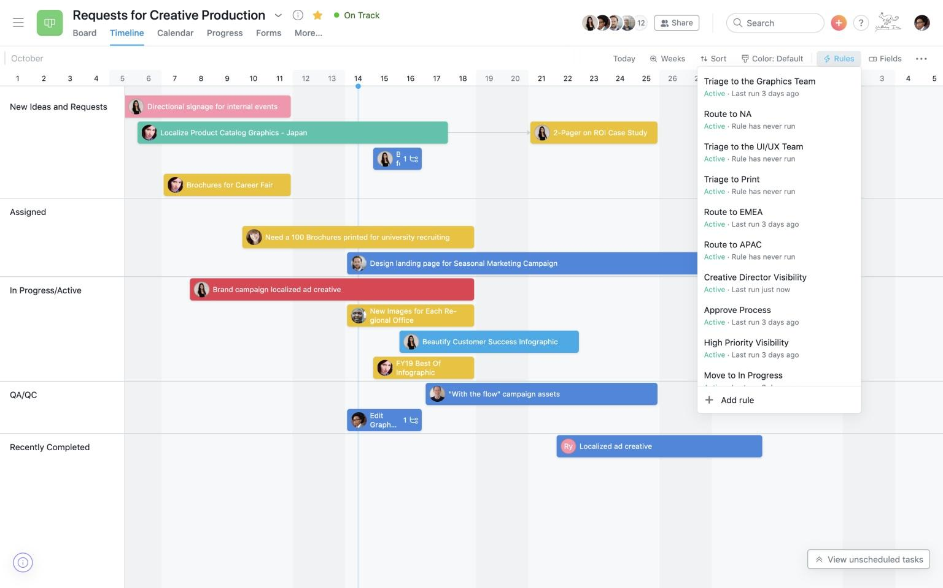
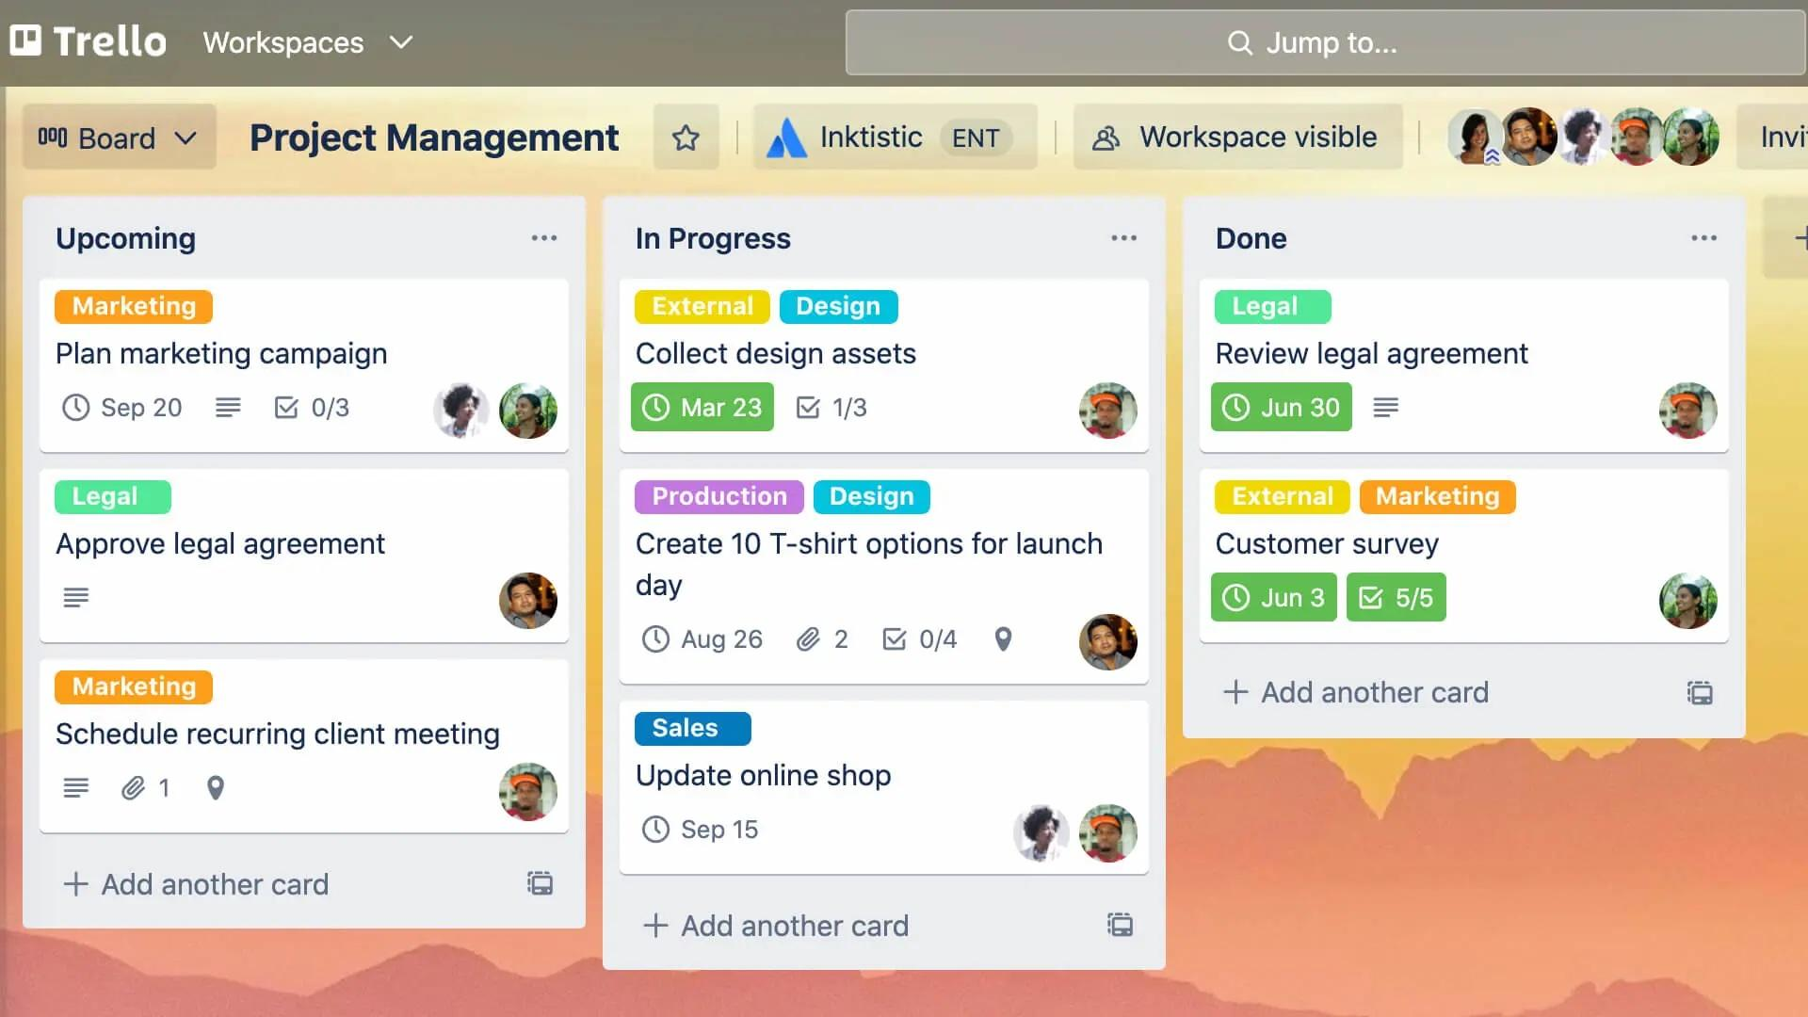
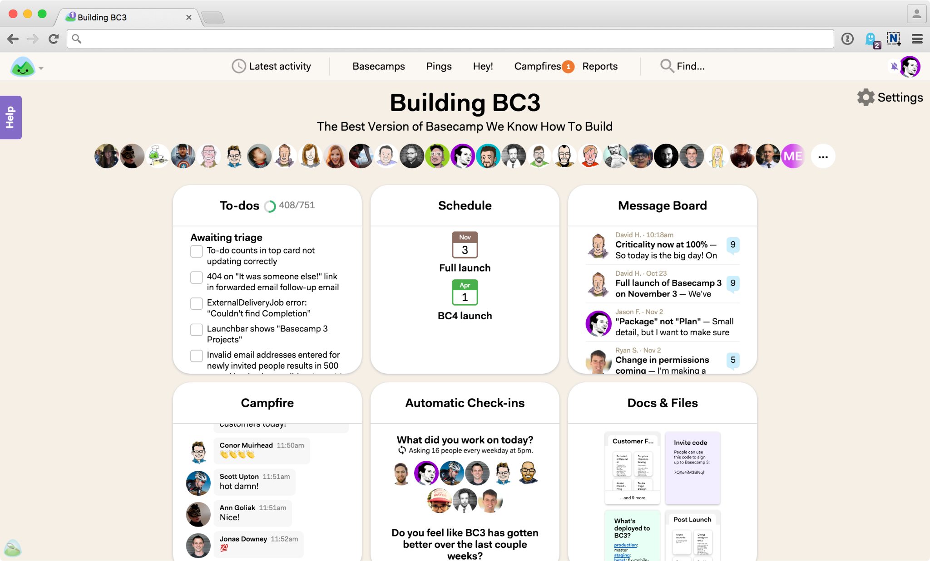
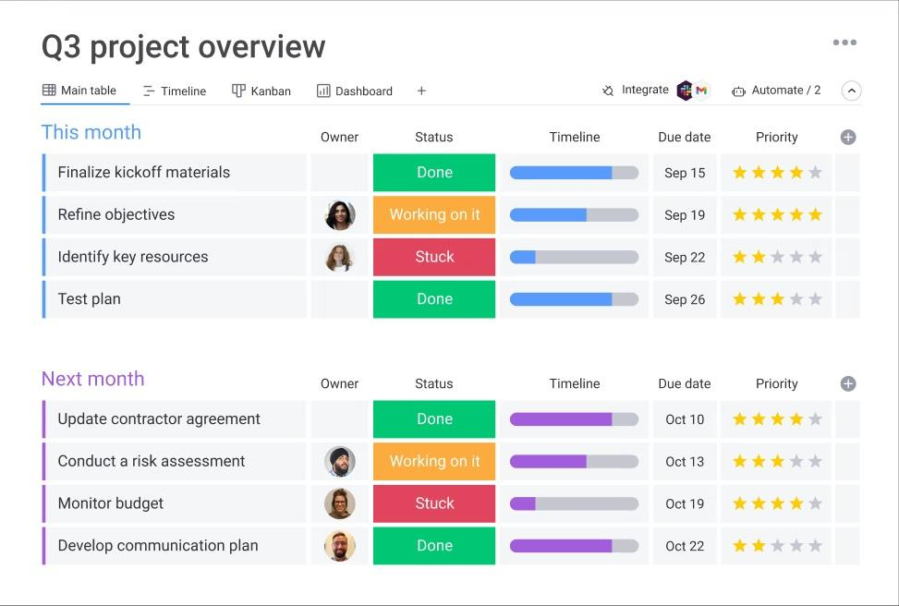
Best (mostly free) project management tools online
Asana
Trello
Basecamp
Monday

Slide 34
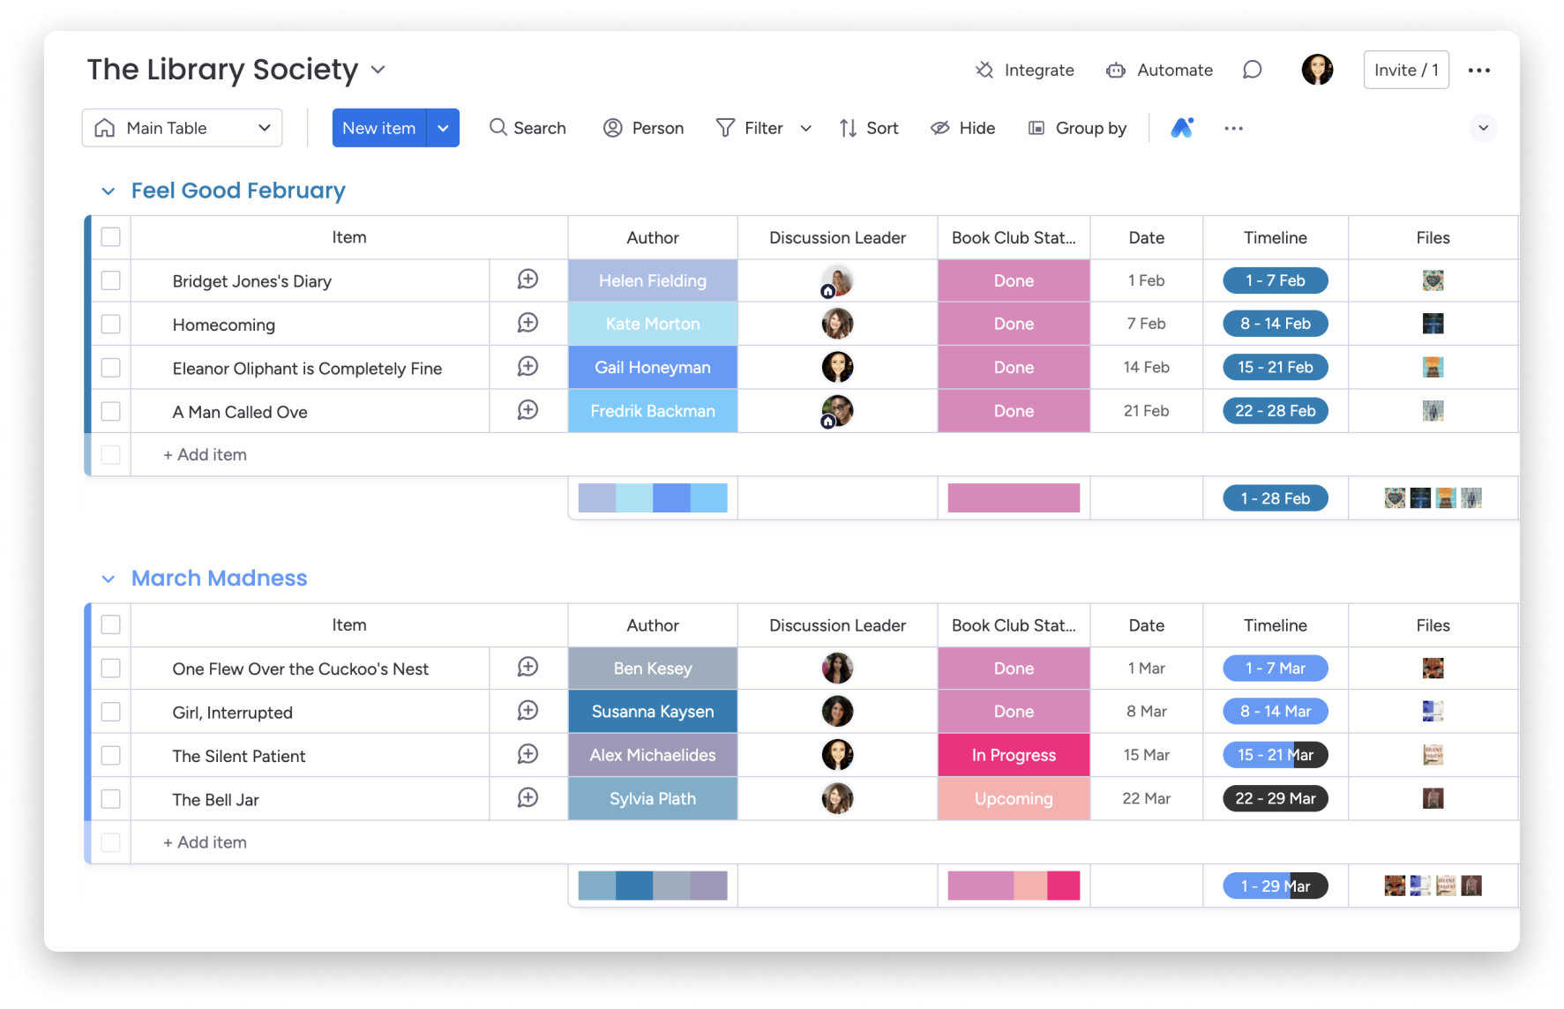
Monday.com Main Table View

Slide 35
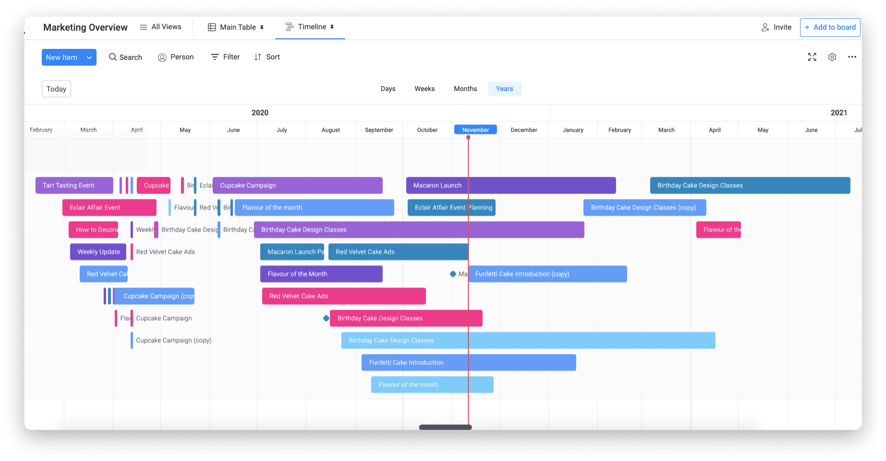
Monday.com Timeline View

Slide 36
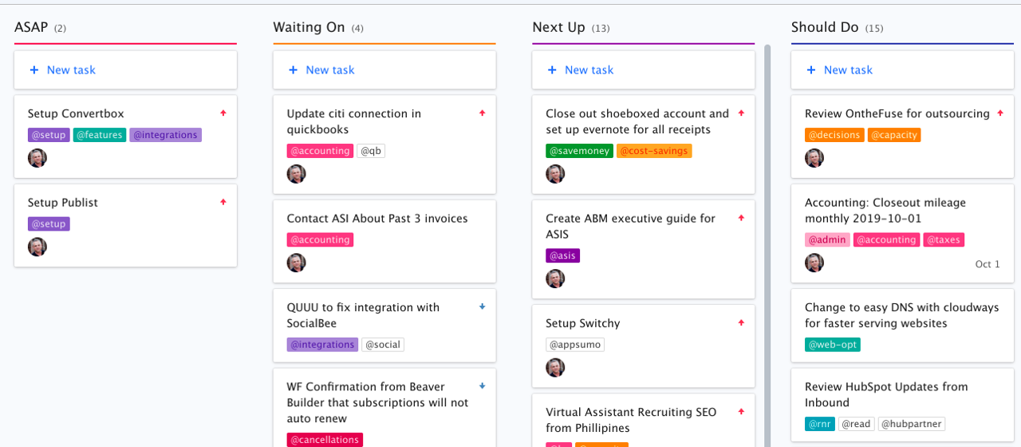
Monday.com Kanban View

Slide 37
Take Home Thoughts

Slide 38
Take home thoughts
You need a to-do list. Really.
It’s a tool box–pick what works for you.
This just scratches the surface–you can go much further with these tools and philosophies.
It applies to not only work, but also school, personal life, etc.

